Slide 1
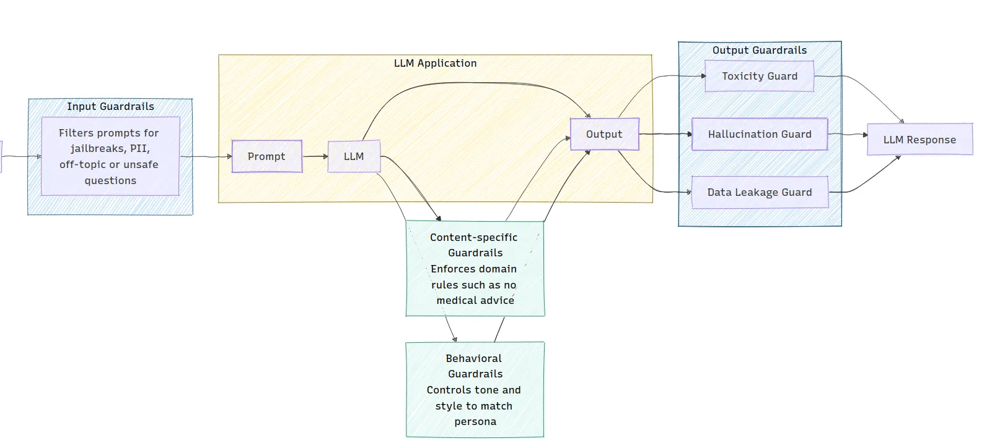
Module 7 – LLMOps & Production Guardrails
The Goal: Moving from a "working prototype" to a "reliable utility."
The Missing Layer: In production, AI systems need boundaries to prevent hallucinations, runaway costs, and safety violations.
Core Focus: Guardrails, Inference Optimization, and Lifecycle Management (CI/CD).

Slide 2
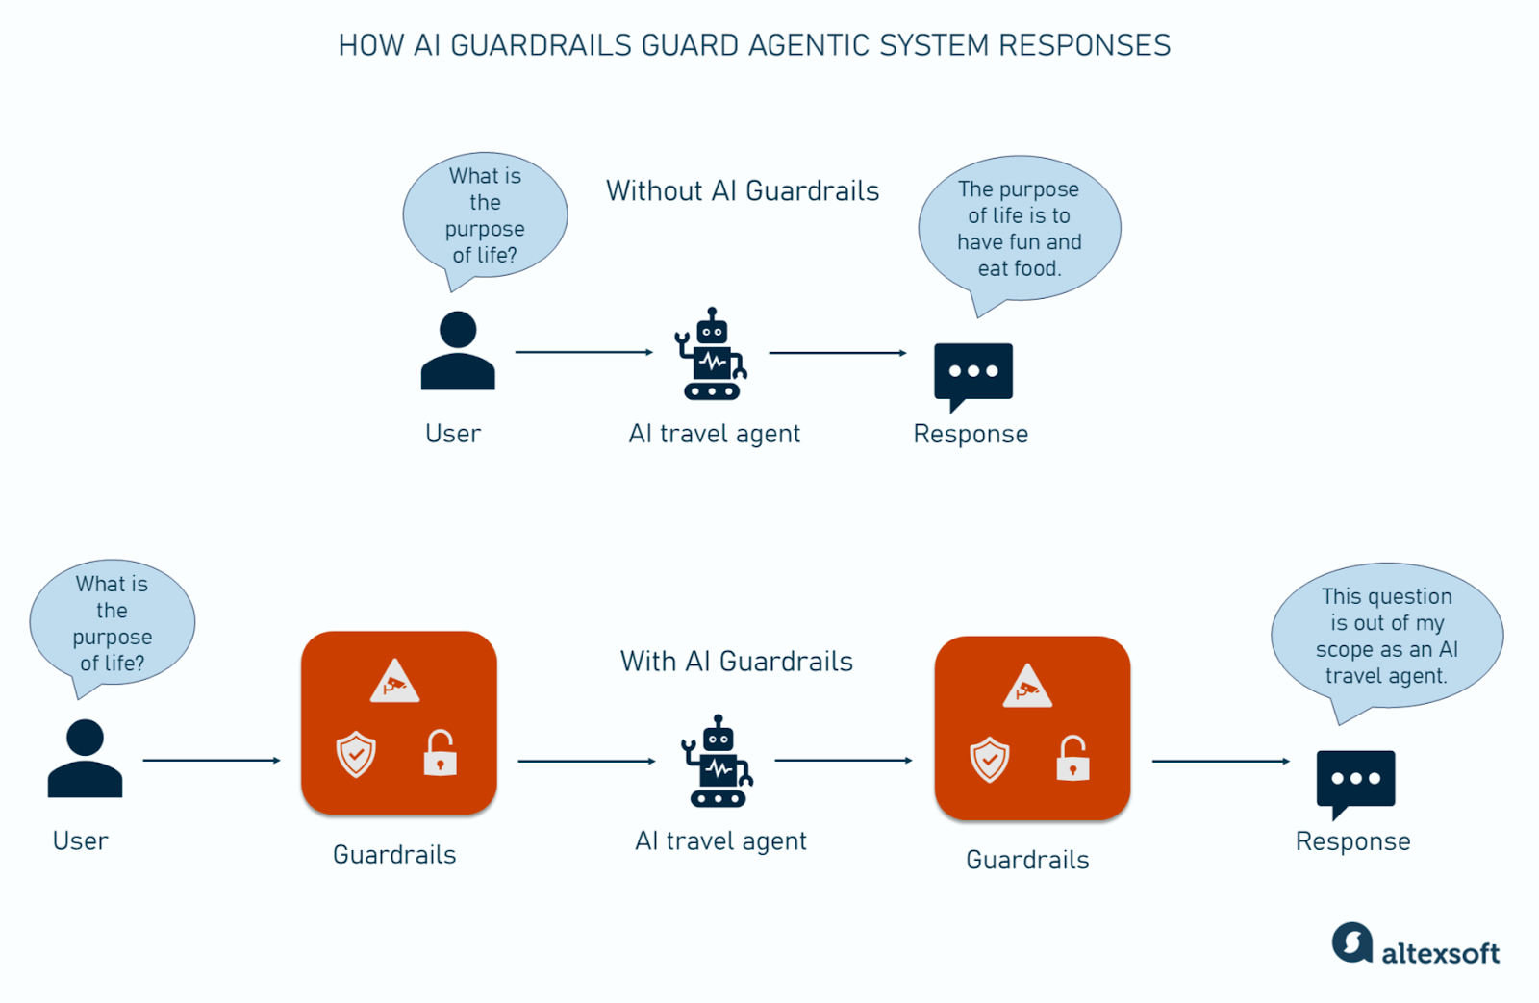
AI Guardrails & Safety
Boundary Enforcement: Using Guardrails AI or NeMo Guardrails to validate inputs and outputs in real-time.
Topical Rails: Ensuring the agent never discusses off-topic subjects (e.g., a Medical Agent shouldn't give investment advice).
Hallucination Filters: Automatically rejecting outputs that don't match the "Memory Vault" context.

Slide 3
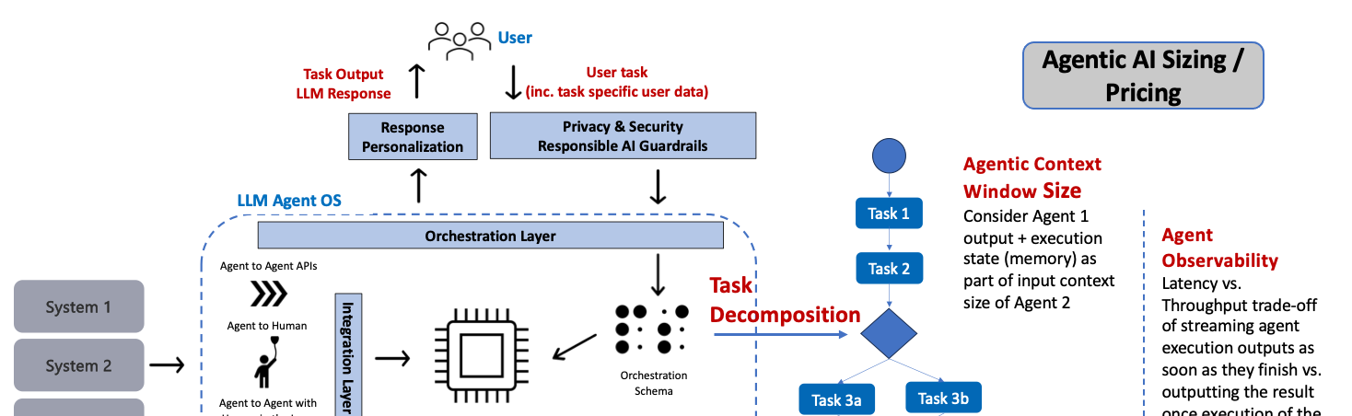
Inference Optimization at Scale
Throughput vs. Latency: Utilizing vLLM and TensorRT-LLM for high-concurrency environments.
Quantization (GGUF/AWQ): Compressing model weights to run Mistral-Large on smaller GPUs without losing technical precision.
Rate Limiting: Protecting your API from being overwhelmed by too many simultaneous agent loops.

Slide 4
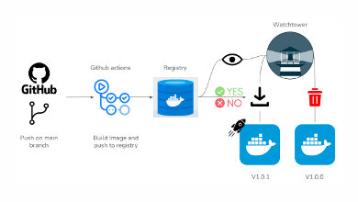
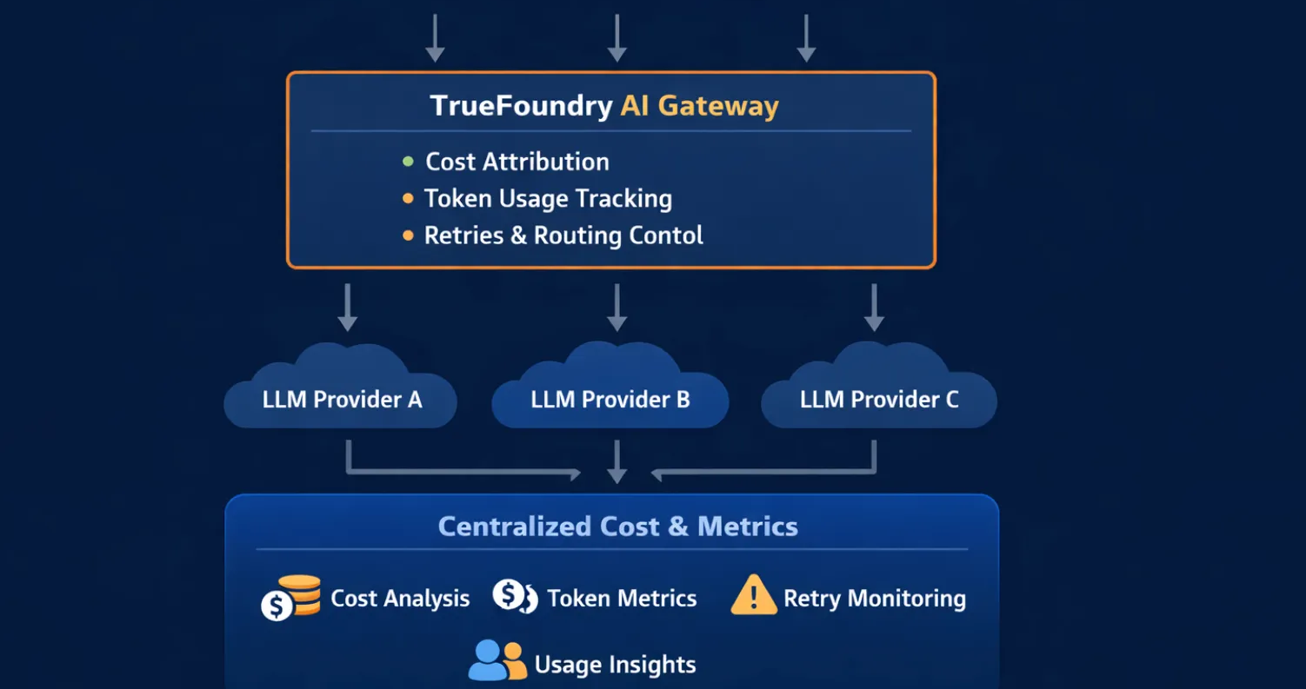
CI/CD & Industrial Observability
Automated Regression Testing: Every time you update the prompt, a GitHub Action runs 50 test cases to ensure the agent's accuracy didn't drop.
Full-Trace Logging: Capturing every "Thought" and "Action" into a central dashboard for post-failure analysis.
Cost Tracking: Real-time monitoring of token usage to prevent unexpected billing spikes.

